Slide 1


姓名：王思潼 英文名：Kaylee 毕业院校：四川外语学院 专业：英语翻译

Slide 2

Welcome To The King of Gloy

Slide 3


VS

Slide 4
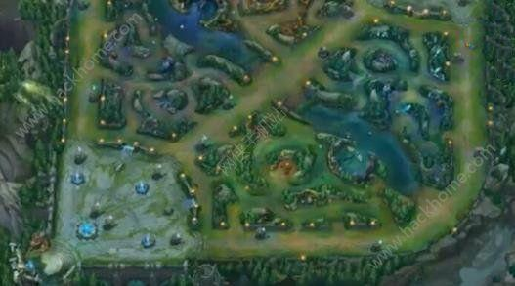
Let’s explore the new world

Slide 5
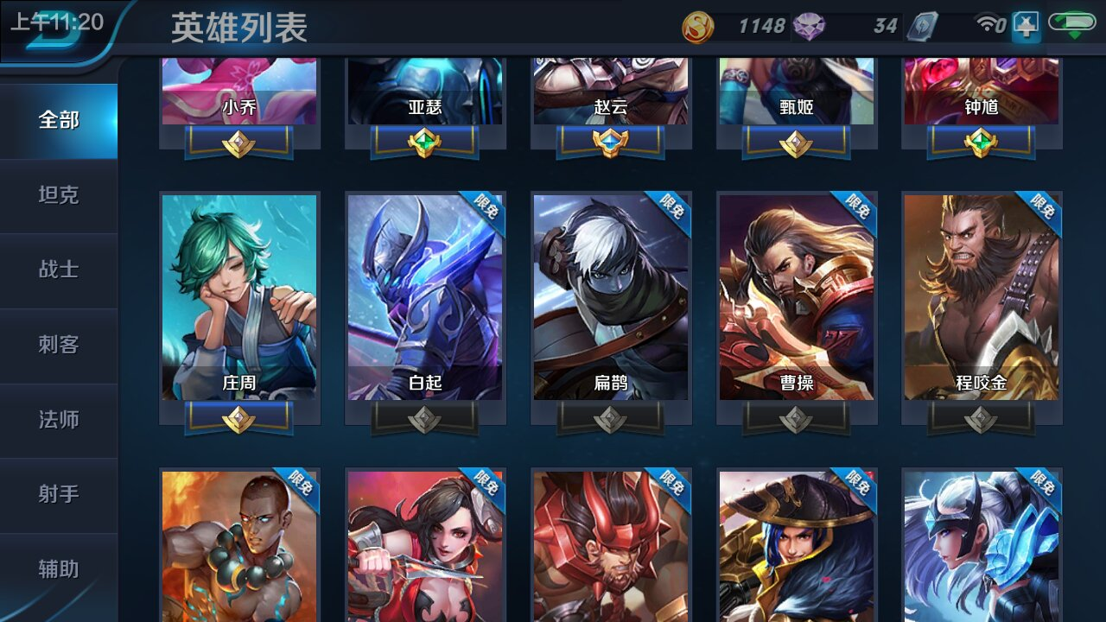

Slide 6
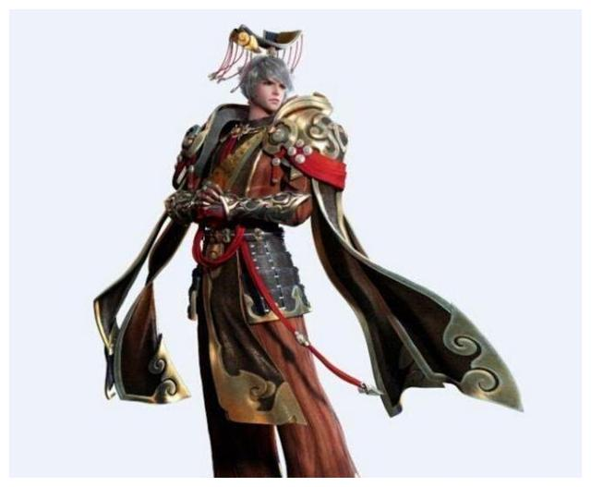


Hero
One
Two
Three

Slide 7
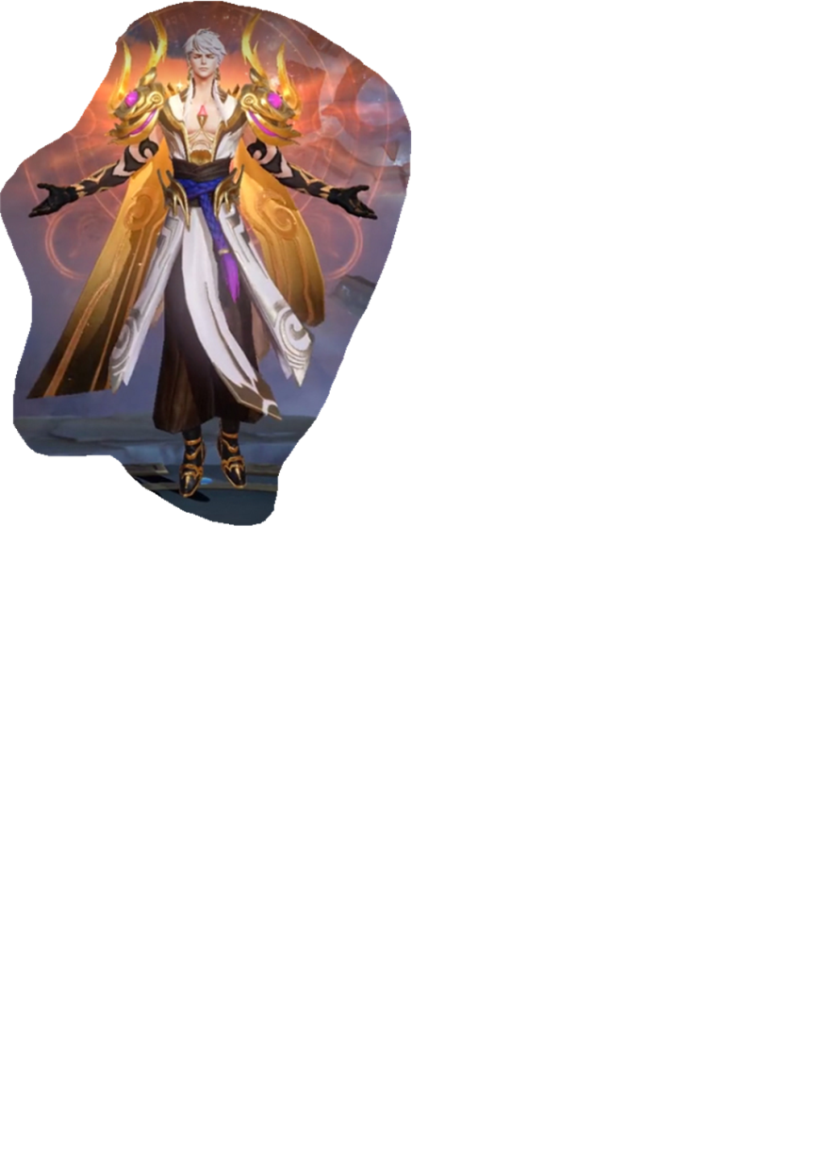


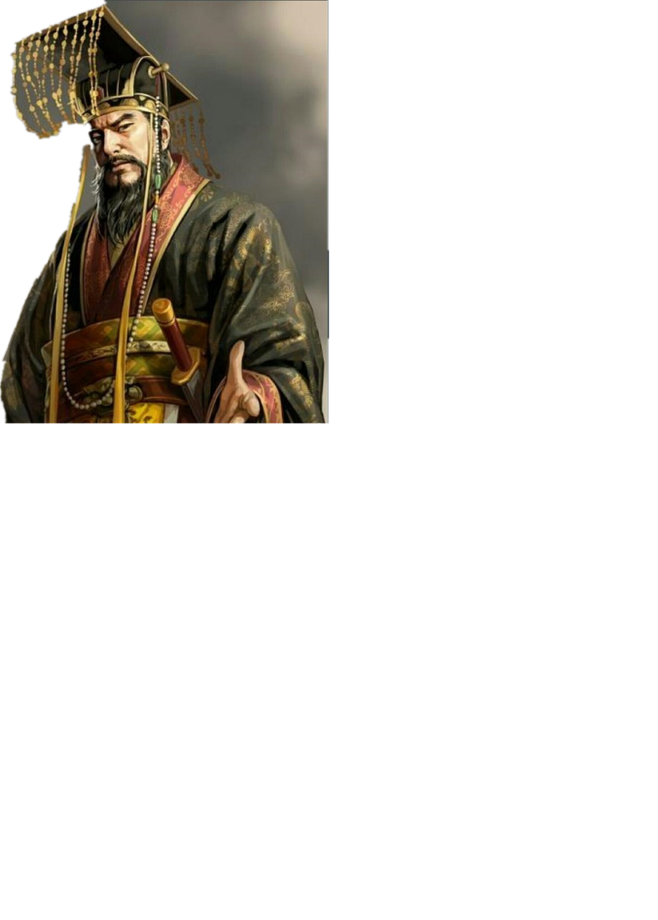

King Letter
a e i
o u

Slide 8


Soldier Letter
b c d f g
h j l m n
p qu=q r s t
v w x y z
tr dr ch sh th or th

Slide 9


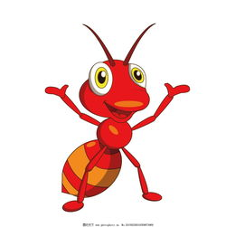


Letter Sound
a b c d e f g
h i j k l m n
o p q r s t
u v w x y z
tr dr ch sh th or th
a e i o u

Slide 10
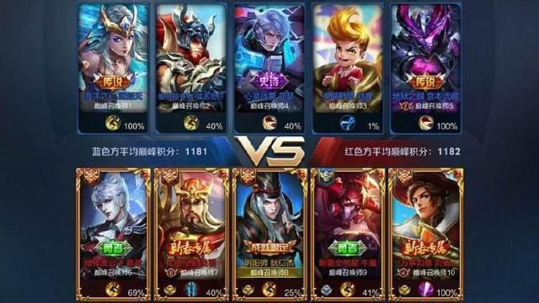

Slide 11


Team Work
h a t

Slide 12

One Kill
hat

Slide 13

Team Work
s l i m

Slide 14

Double Kill
slim

Slide 15
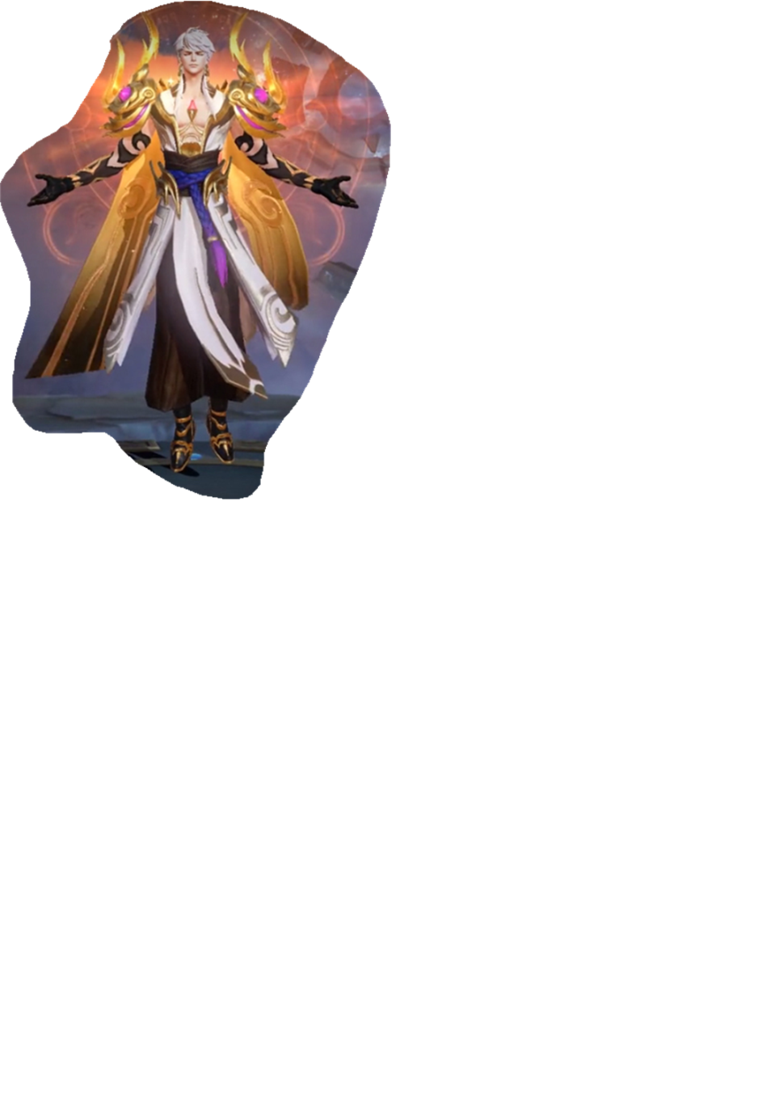
Team Work
f a s t

Slide 16

Triple Kill
fast

Slide 17





Practice
bag cap ham sand snack
bed desk pen red ten
dog hot not sock
us up bus gum such but dust
is it ill fish big flim dish swim
box cost doll fog fox god log
jet bet let met kept slept swept

Slide 18



Practice
lab | grass | miss | buff | fact
gas | pass | shaft | glass | cliff
jab | task | grab | class | gruff
brass | staff | slad | kiss | buff
craft | mask | fax | gaff | pass

Slide 20
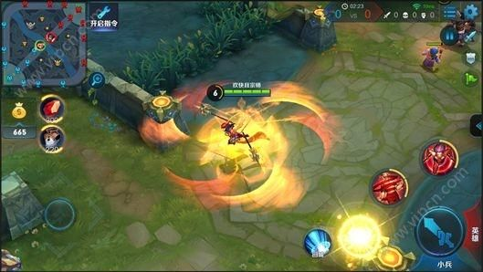
Words spelling competition
Round 1
cup fast hat net sad hit
bad at must big just

Slide 21





Team Work
h a b i t
1

Slide 22
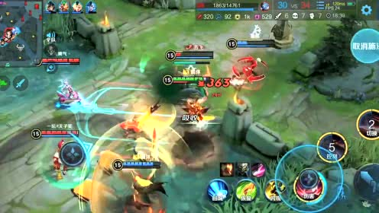
Words spelling competition
Round 2
solid habit
family bodily

Slide 23
Long vowels
a_e ee i_e o_e u_e
a + “_e”=a_e
e +“_e”=ee
i +“_e”=i_e
o +“_e”=o_e
u +“_e”=u_e

Slide 24
a_e
cake | grape | make | skate
hale | gale | snake | safe
game | plate | lake | name

Slide 25
Practice
ee green sleep three
i_e kite like time white
o_e close home nose
u_e bute cute tube use

Slide 26
Words spelling competition

Slide 27

safe lake sleep three
kite time
close home cute tube

Slide 28
考试连接
选出划线部分读音不同的选项
wake B. sadly C. angry D. happily
A. strong B. hole C. forest D. dog
tidy B. kite C. milk D. bite
A. safety (后缀） B. traffic C. brave D. pavement（后缀）

Slide 29
review
a b c d e f g
h i j k l m n
o p q(u) r s t
u v w x y z
tr dr ch sh th or th
a_e ee i_e o_e u_e

Slide 30
review
1
从后往前找
2
找到皇帝音元音
6
从前往后按顺序读出来
3
5
4
找到将军音辅音
两者拼读在一起
找到蔡文姬散辅音
hot habit lake

Slide 31
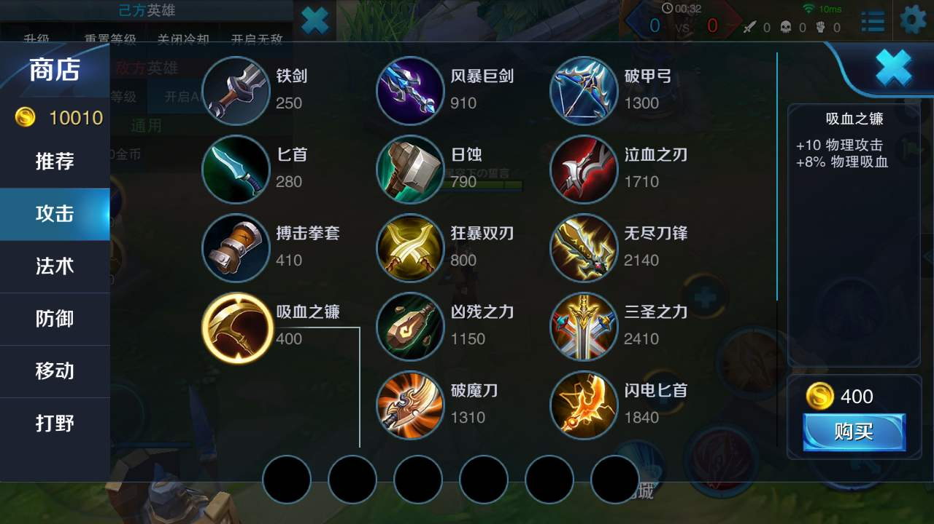

Slide 32


